Slide 1
SPIGELIA ANTHELMIA
Dr.P.R.SAIJI
ASSOCIATE PROFESSOR
DEPT OF MATERIA MEDICA

Slide 2
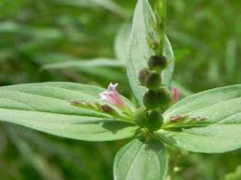
SPIGELIA ANTHELMIA
Common name-pink-root
Other names
Worm glass, Indian pink, Maryland pink, Carolina pink, American worm grass, American pink root, star bloom.
Part used
Tincture of dried herb
Prover-Dr Samuel Hahnemann
Alkaloid -sideline

Slide 3
Spigelia is a native of the southern states of north America. it is known in Europe in Hahnemann’s time as an anthelmintic, this property of the drug having been learned from the negroes of the Antilles.
The numerous long thick rootlets are said, in the Doctrine of Signature, to give the appearance of small snakes or large worms, inferring its good use as a vermifuge.

Slide 4
MIND
Sadness and discouragement.
Agitation and anxiety, with restless care concerning the future.
Timidity.
Afraid of pointed things , pins , etc.
Sits as if lost in thought , stares at a single point.
Moroseness , to the extent of suicidal mania.
Great dejection in evening ; he could have killed himself(with chilliness of body)

Slide 5
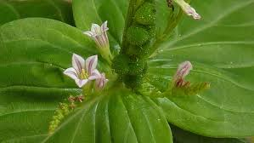
MIND
Weakness of memory.
Absence of ideas.
Difficulty of thinking.
Unfitness for intellectual labor.

Slide 6
HEAD
Head confused , as from intoxication or dizziness.
Giddiness when looking downwards.
Vertigo, to such an extend as to fall down when walking , standing , or looking down.
Vertigo ,with nausea
Headache , on shaking head ,with vertigo, and sensation of heaviness
Neuralgic pain flying from one part to another

Slide 7
Head symptoms……………..
Headache beginning in cerebellum , morning , spreading over left side of head , causing violent and pulsating pain in left temple and over left eye , with stitches in left eye; returning periodically.
Painfulness of cerebellum with stiffness of neck.
Heaviness of head.
Drawing pain of facial muscle with sensation of skull will burst upward.

Slide 8
Continues………………….
Fine burrowing-tearing pains in brain , esp. , violent in the left parietal bone.
AGGRAVATION
On false step , every jar , least movement.
After rising , stooping , during movement.
Amelioration
Lying with head high.
At rest.

Slide 9
EYES
Neuralgia of eyes with great soreness , cannot bear to be touched.
Affection of eyeball , eyelids , optic nerve.
Dilated pupils.
Ocular illusions , sees strange things , fiery, luminous rays , sparks.
On shutting eyes a sea of fire appears.
Illusion as if hairs or feathers on the lashes.
Tingling in eyes
itching in right eyeball , returning after rubbing.

Slide 10
Continues……….
Pain as if needles thrust into right eyeball.
Movement of eyes and muscles of face aggravate the pains.
Great sensitiveness of eyes to light .
Hanging down of lids as from paralysis.
Sensation as of hard substance under right upper lid amelioration by rubbing
Tendency to wink.
Weakness of eyes.

Slide 11
EARS
Earache with an ichorous , scalding, discharge; hearing very sensitive , noise in the ear as if something fluttering.
Pain in margin of left concha.
Pressing pain in right ear.
Jerking tearing in ears.
Squeezing itching and burning sensation in external ear.
Periodical deafness.

Slide 12
NOSE
Forepart of the nose is always dry .
Discharge through the posterior nares
Chronic catarrh with post-nasal dropping of bland mucus.
Tickling on back of nose ,as if lightly touched by hair.
Herpetic eruption with excoriation.
Frequent sneezing with bloody discharge.
Frequent clear coryza.

Slide 13
FACE
Prosopalgia , involving the eye , zygomatic region , cheek , temples ,worse stooping , touch , from morning till sunset .
Face pale and wan ,with yellow circles round eyes.
Redness of face; perspiration on face .
Burning in right side of upper lip.
Bloatedness of face ,especially after sleeping .
Exostosis of the temporal part of the orbit.

Slide 14
TEETH
Toothache after customary smoke in evening.
Toothache ameliorated by tobacco smoke.
Pressing pain under the teeth immediately after meals.
Unable to sleep at night , due to tooth ache.
Toothache ameliorated by warmth of bed, while eating and lying down.
Aggravation by lying on right side & cold water application.

Slide 15
MOUTH
Offensive exhalation from the mouth, noticed only by others.
Lancinating dryness in mouth on waking in morning.
Much white , frothy saliva in mouth.
White or yellow mucus in mouth and palate
Tongue cracked.
Vesicles with burning pain on tongue and palate
Pain of cancer of tongue

Slide 16
THROAT
Sore throat .
Lancinations and swelling in palate.
Discharge of mucus from fauces all the day.
Cervical gland swelling.
APPETITE
Putrid fetid taste- anorexia , with violent thirst.
Dislike to coffee.
Bulimia, sometimes with nausea and thirst.

Slide 17
STOMACH
Rising after meal , sour rising.
Nausea when fasting ,sensation as something would ascent from stomach to throat.
Accumulation of mucus in the stomach.
Pressure in the stomach and scrobiculus as from a heavy body.
Lancinations at pit of stomach and diaphragm.
Dull stitches at pit of stomach , aggravation from inspiration.

Slide 18
ABDOMEN
Griping in abdomen, as if intestine constricted, with anxiety and difficult breathing.
Abdomen hard and painfully tight .
Stitches at region of diaphragm, left side, arresting breathing .
Pressure in umbilical region, as by a hard body.
Colic, with pinching pains, cutting in umbilical region, as by a hard body.
Painful pressure at lower abdomen, as if it would burst esp. in evening ameliorated by stool and fetid flatus .

Slide 19
STOOL AND ANUS
Frequent, urgent, and ineffectual want to evacuate .
Soft ,liquid faeces.
White stool daily , nodular stool with violent pressure.
Faint during stool.
Liquid diarrhoea of faecal matter and of mucus. Boring stitches in perineum.
Diarrhoea ,with pinchings in abdomen and coldness of body, discharge of faeces with worms.

Slide 20
URINARY ORGANS
Urine, with whitish sediment.
Frequency increased, with profuse emission, even at night.
Sudden and involuntary dribbling of urine , burning sensation in the anterior part of urethra.
Discharge of prostatic fluid from the urethra.
MALE SEXUAL ORGANS
Tingling round glans penis .
Semilateral swelling of glans .
Erections, with lascivious ideas, without voluptuous excitement.
Itching stitch in right testicle and penis, from behind forward.

Slide 21
RESPIRATORY ORGANS
Catarrh, with hoarseness, continual discharge of mucus from nose ,dry heat without thirst, prominent eyes, distressing headache, and disposition to weep.
Nocturnal catarrh , with cough.
Cough in open air, with pain in chest as from excoriation.
Short dry cough causing soreness of chest.
Dyspnoea when moving in bed can only lie on right side. least movement aggravation.

Slide 22
CHEST
Aching at the chest with painful oppression.
Contraction of chest ,with anguish and obstructed respiration .
Stitches in diaphragm with dyspnoea .
spinning wheel like noise at heart region.
Cutting tearing beneath left nipple ,extending to region of scapulae and upper arm. aggravation during inspiration and moving arm.
Spasmodic sensation in chest.
Tensive laceration in chest esp. when drawing breath

Slide 23
HEART
Violent palpitation of heart ,perceptible to sight and hearing , often with anxious oppression of chest.
Violent oppressive action of heart extending to top of head
Tumultuous action of the heart in acute rheumatism and other acute disorders

Slide 24
NECK AND BACK
Needle like stitches in upper dorsal vertebrae; in right scapula.
Sensation in left scapula as though blood were dripping through a valve ,a kind of bubbling.
Red pimple on neck, with pain as form excoriation when touched .
Hard and painful swelling of glands of the neck.
Pain in nape aggravation from rest(still) amelioration from motion .

Slide 25
EXTREMITIES
Heaviness and trembling of arms . Easy numbing of arms and hand.
Jerking of muscles of arms and forearms.
Violent lancinations and shocks in bend of elbow and joints of hands and fingers .
Spasmodic drawing and tearing in bones of hands.
Hard nodosities in the palms ,with burning itching.
Hand of a pale yellow colour. contracture of fingers.

Slide 26
Continues…………..
Pain as of a fracture , tension and shooting in thighs ,almost exclusively, when walking or during rapid movements .
Painful stiffness at knee joint .
Stitches at all joints .
Excrescences, like warts, on toes

Slide 27
GENERALITIES
Violent neuralgia with extreme soreness , boring pains. pain as if parts were pushed or pressed as under .
Right sided
Great weakness especially morning .
Aggravation by touch of affected part.
Amelioration while taking an inspiration.
Arthritis shooting tearing pains in limbs.
Convulsions
Lassitude,esp.after slight exercise,and in open air.

Slide 28
SKIN
Pale wrinkled skin of body.
Painful sensibility of entire skin when touched
Painful glandular swellings.
Red pimples ,with pain as from excoriation , when touched.

Slide 29
SLEEP
Strong disposition to sleep by day ,and also in morning or evening ;without sleeping until long after lying down.
Sleep at night unrefreshing , agitated with uneasiness in limbs .
Heavy ,stupefying sleep.
Confused dreams ,which cause him to awake wearied and which he cannot remember.

Slide 30
FEVER
Pulse irregular ,generally strong but slow.
Trembling pulse.
Frequent shivering esp., in morning or during slight exercise.
Chill, frequently returning at the same hour in the morning .
Chill alternate with heat or sweat.
Chill extend from the chest, heat especially in the back.
Clammy perspiration, cold perspiration.

Slide 31
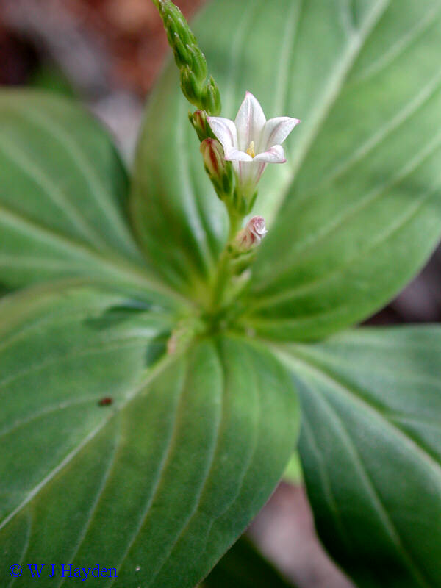
MODALITIES
WORSE FROM
Touch
Motion
Noise
Turning
Washing
Concussion
BETTER
Lying on right side with head high
inspiration

Slide 32
RELATIONSHIP
Compare;
Spigelia marylandica(maniacal excitement, paroxysmal laughing and crying, loud, disconnected talking, vertigo, dilated pupils, congestions);
acon; cact; cimic; arn.(spig is the chronic of Arn.);
cinnabar.(supra-orbital pain);
naja; spong.(heart);
sabad; teucr; cina (worm symptoms)
Antidote ;puls.

Slide 33
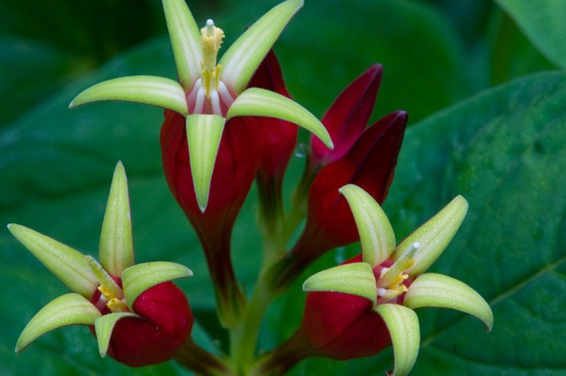
SPIGELIA MARILANDICA
COMMON NAME
Pink root.
Worm-grass.
FAMILY
Loganiaceae.
PART USED
Tincture of root.

Slide 34
CHARACTERISTICS
Mainly occur due to over dosing.
Mania.
Strabismus of right eye.
Sudden mental derangement.
Countenance distorted, running and skipping.
Fits of laughing and crying, pupils greatly dilated.
Talk wild and incoherent.

Slide 35
HEAD
Vertigo.
EYES.
Wild staring ludicrous expression.
Irregular movement of adductor and abductor of eyes.
Strabismus of right eye.
Pain in and about the eye
Sensation of stiffness of eyelids.
Pupils dilated

Slide 36
FACE
Much swelling of face and about eyes.
Face flushed.
MOUTH
Tongue pointed and tremulous.
HEART
Pulse,accelerted;irregular.
GENERALITIES
On attempting to assume erect position, seized with general tremour lasting a few seconds and leaving her exhausted.

Slide 37
SLEEP
Drowsiness.
FEVER
Skin hot and dry.

Slide 38
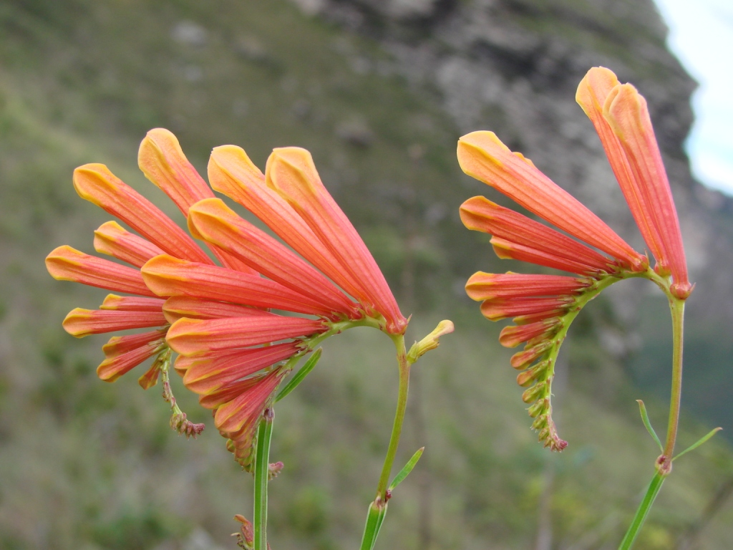
THANK YOU…………………..

